Slide 1
WireFrame & Estimate

Slide 2
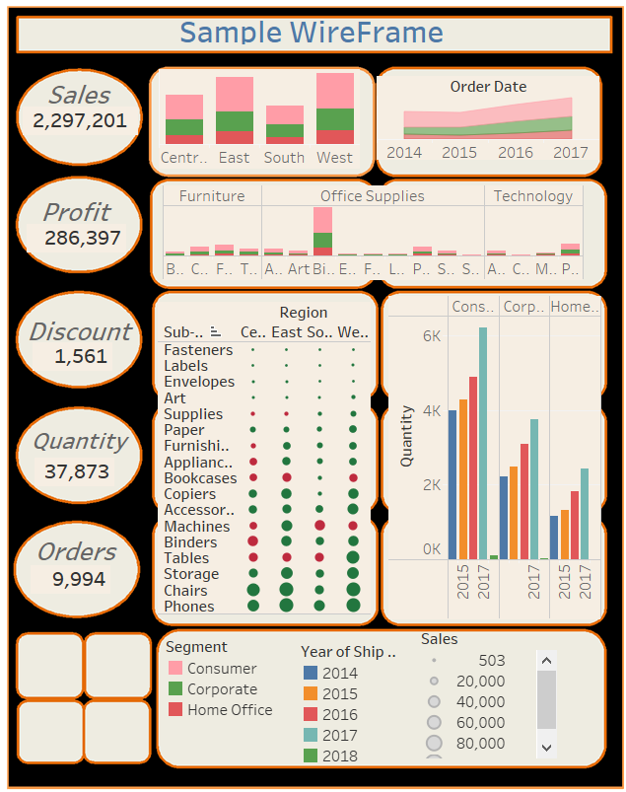
WireFrame

Slide 3
Estimates
Task to perform | Hours required for task(Hours) | Cost per Hour(RSs) | Total Cost
Data gathering and cleaning | 2 | 350/- | 700/-
Analyzation | 2 | 300/- | 600/-
Creation of KPI’s | 2 | 300/- | 600/-
Building wireframe | 4 | 500/- | 2000/-
Creating Charts & Graphs | 6 | 350/- | 2100/-
Creating Dashboard &Stories | 6 | 600/- | 3600/-
Insights & conclusion | 3 | 400/- | 1600/-
Total Estimates | 25 | 2500/- | 11200/- + (18%GST)
Note : Cost may vary depends on the complexity of data

